Slide 1



Facebook and Instagram for library people and friends

Slide 2
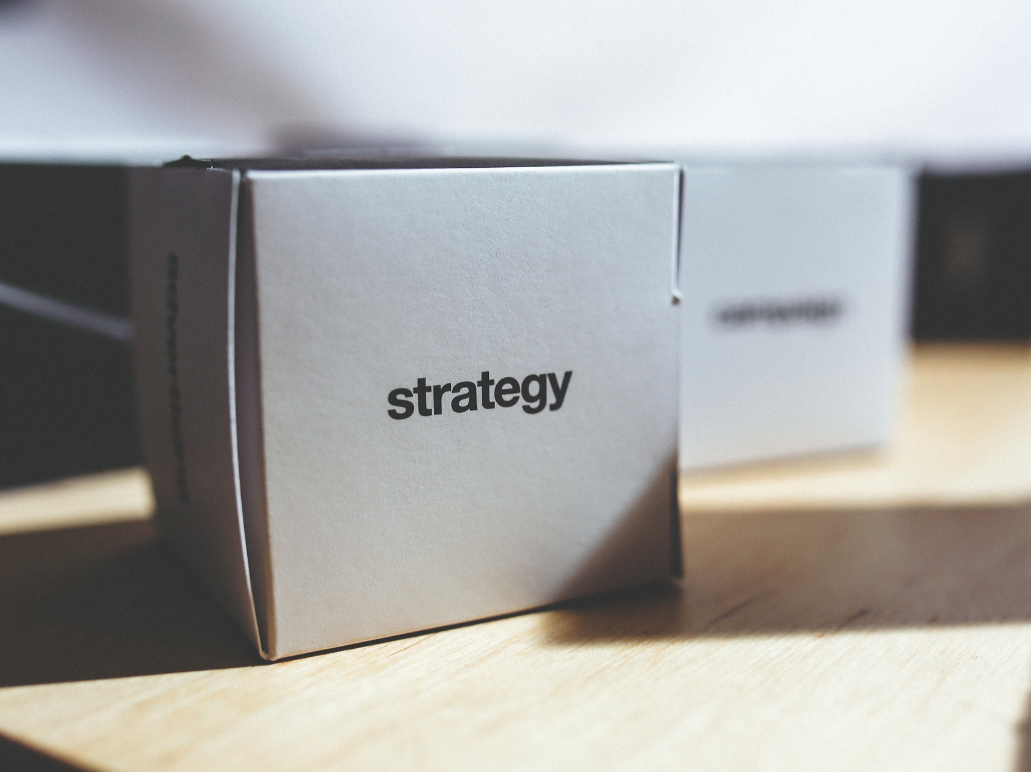
Notes:
Why are you using social media?
To build contacts, share content, promote events?
How does it fit with your current online presence?

Slide 3

Notes:
FB – online community

Slide 4
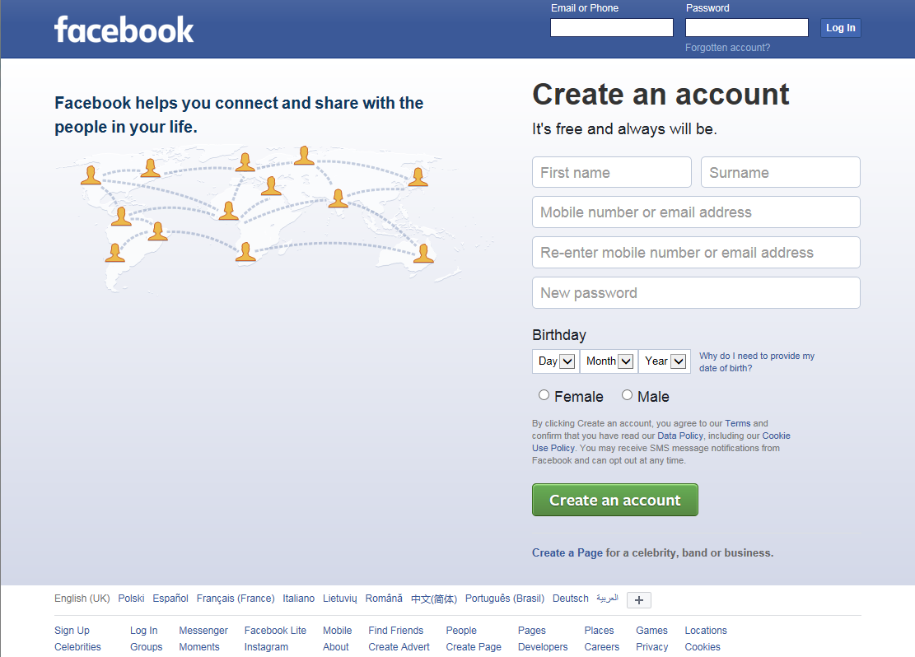
Notes:
Need to create a “personal” account before creating a Page.

Slide 5
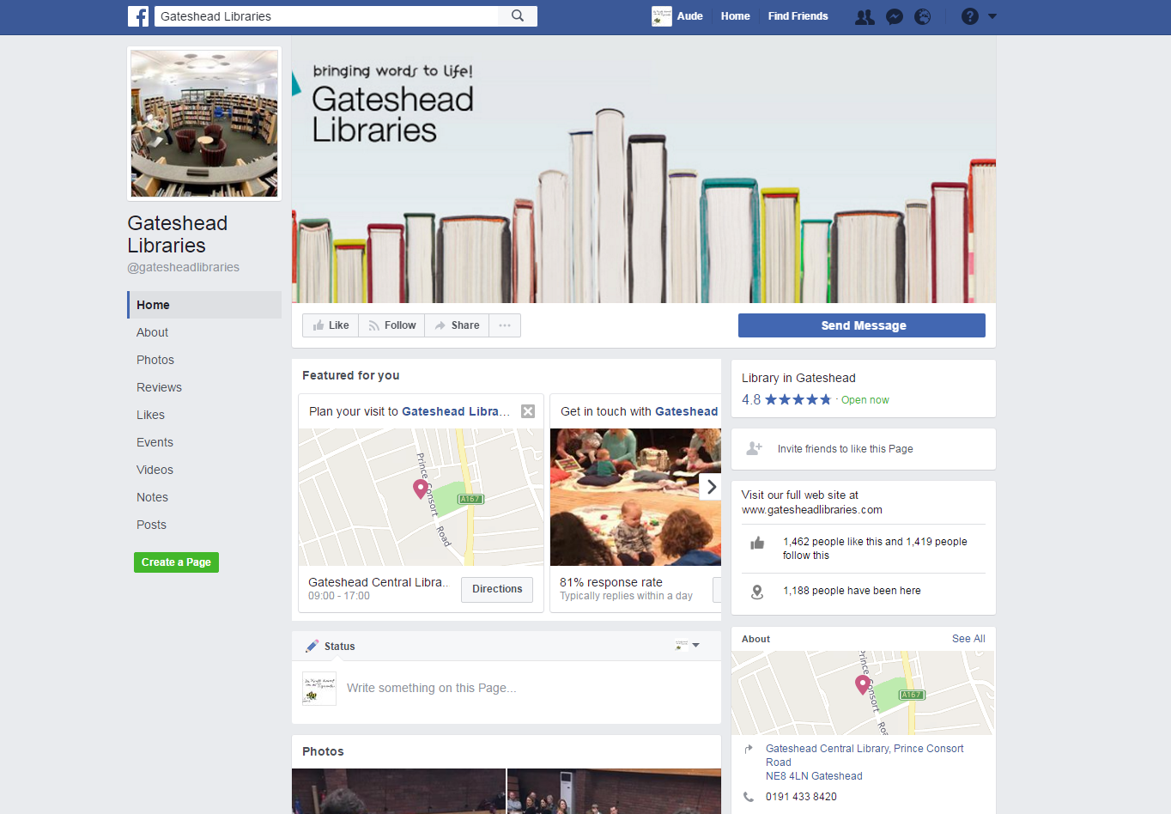

Slide 6
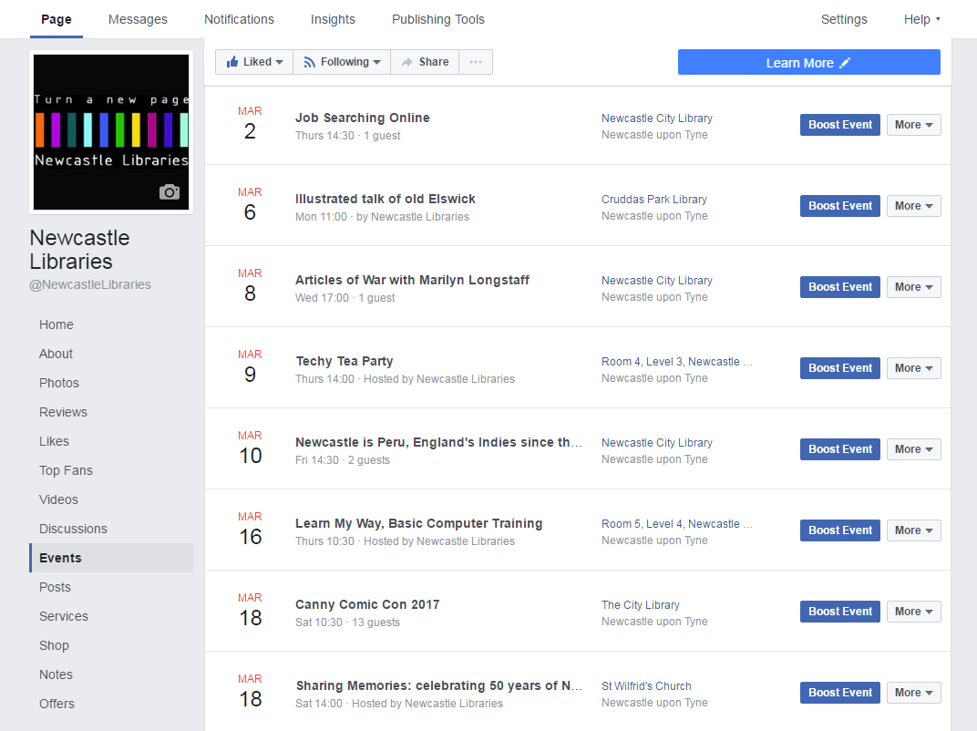
Notes:
Events page

Slide 7
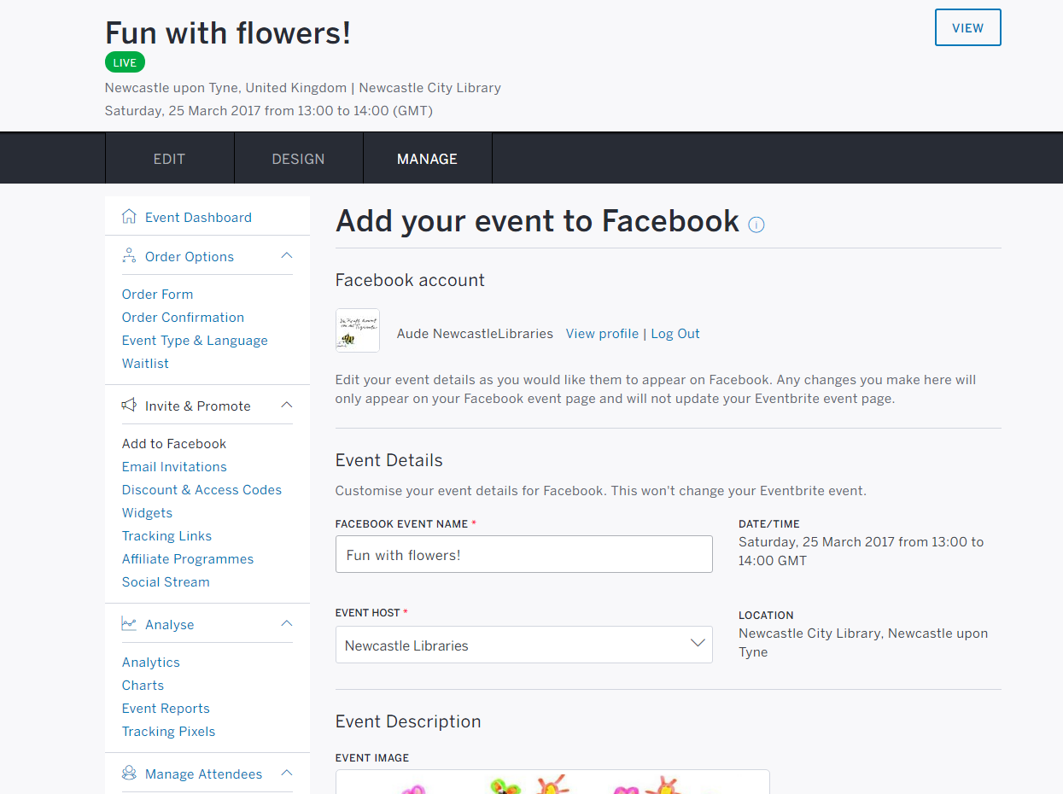
Notes:
Eventbrite – Facebook integration

Slide 8
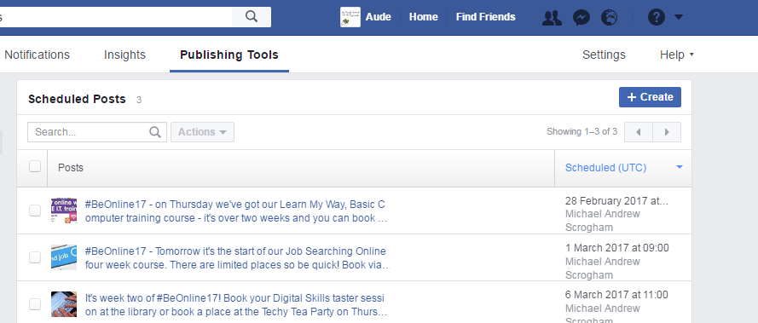
Notes:
Possibility to schedule posts

Slide 9


Slide 10
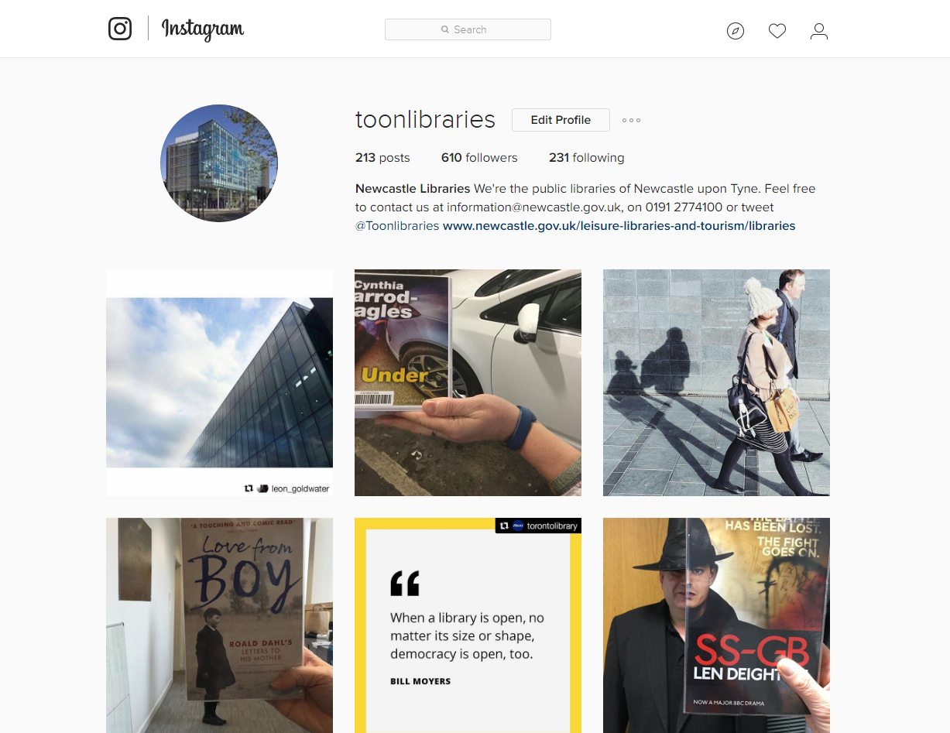

Slide 11
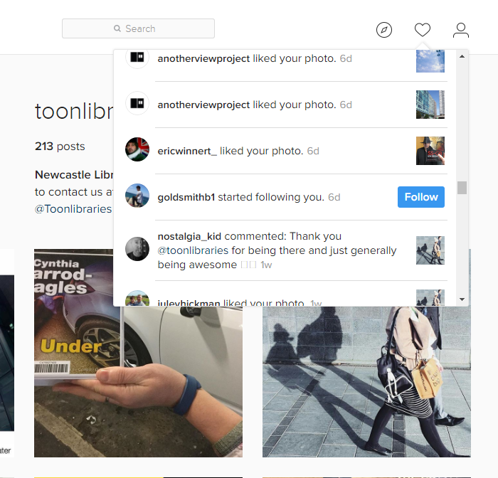
Notes:
Notifications

Slide 12
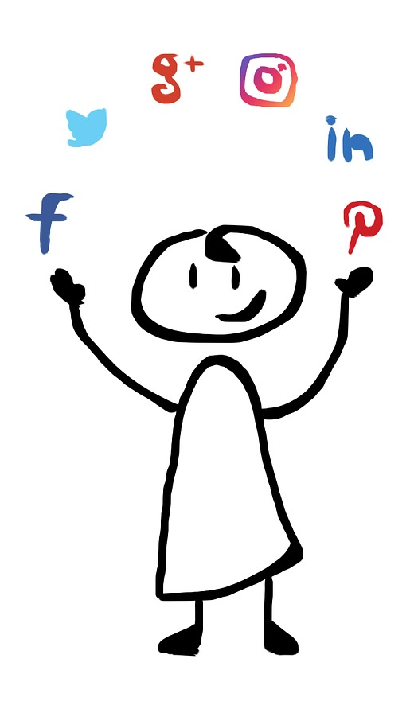

What questions or comments
do you have?
Training for staff - Newcastle Libraries, March 2017
Published under a Creative Commons Attribution licence (CC BY)

